Slide 1
Backpropagation of Convolutional Neural Network

Slide 2
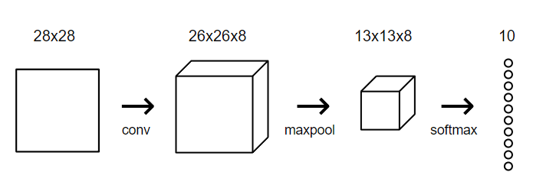
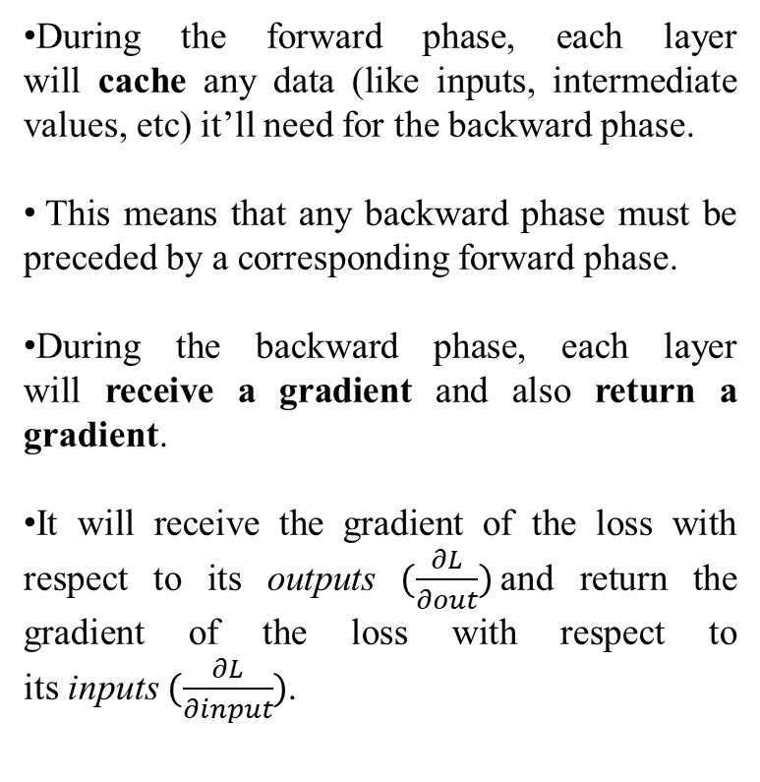
Recap
During the forward phase, each layer will cache any data (like inputs, intermediate values, etc) it’ll need for the backward phase.
This means that any backward phase must be preceded by a corresponding forward phase.
During the backward phase, each layer will receive a gradient and also return a gradient.
It will receive the gradient of the loss with respect to its outputs $(\frac{∂L}{∂out})$and return the gradient of the loss with respect to its inputs $(\frac{∂L}{∂input})$.
CNN takes a 28x28 grayscale image and outputs 10 probabilities, 1 for each digit

Slide 3
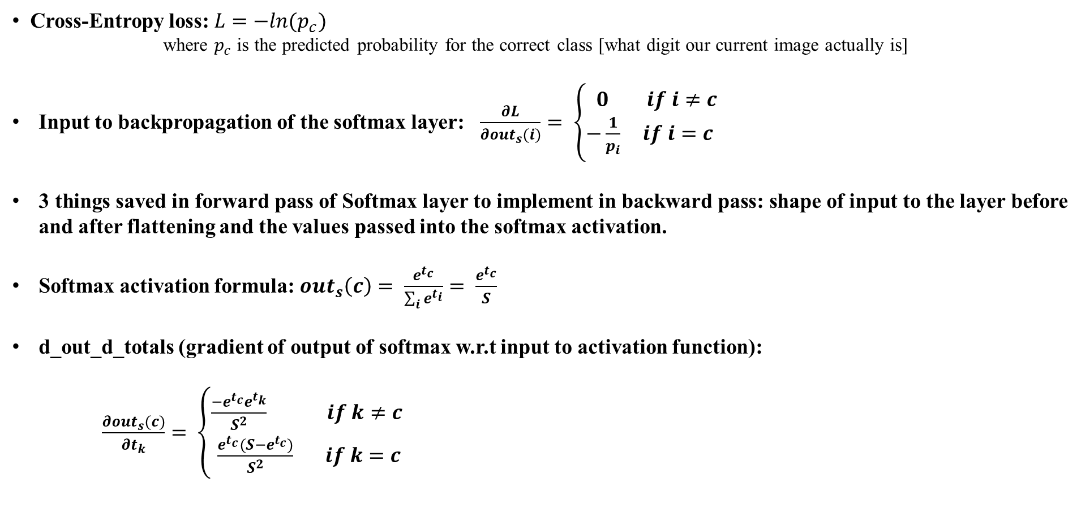
Recap
Cross-Entropy loss: $L=−ln(p_{c})$
where $p_{c}$ is the predicted probability for the correct class [what digit our current image actually is]
Input to backpropagation of the softmax layer: $\frac{∂L}{∂out_{s}(i)}= \left\{\begin{aligned}0 if i≠c \\ −\frac{1}{p_{i}} if i=c \end{aligned}\right.$
3 things saved in forward pass of Softmax layer to implement in backward pass: shape of input to the layer before and after flattening and the values passed into the softmax activation.
Softmax activation formula: $out_{s}\left(c\right)= \frac{e^{t_{c}}}{\sum_{i}{e^{t_{i}}}}= \frac{e^{t_{c}}}{S}$
d_out_d_totals (gradient of output of softmax w.r.t input to activation function):
$\frac{∂out_{s}(c)}{∂t_{k}}= \left\{\begin{aligned}\frac{−e^{t_{c}}e^{t_{k}}}{S^{2}} if k≠c \\ \frac{e^{t_{c}}(S−e^{t_{c}})}{S^{2}} if k=c\end{aligned}\right.$

Slide 4
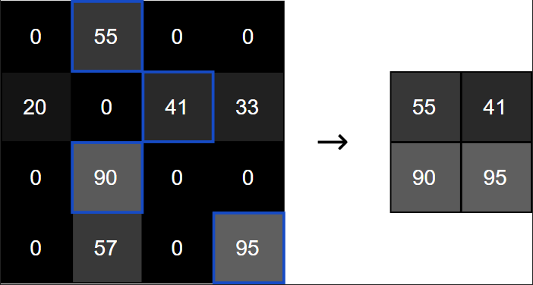
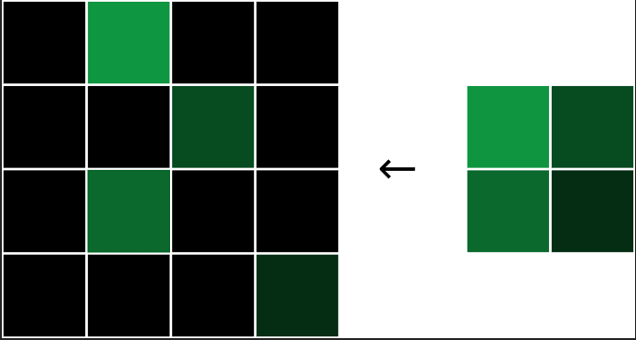

Backpropagation: Maxpooling
During the forward pass, the Max Pooling layer takes an input volume and halves its width and height dimensions by picking the max values over 2x2 blocks. The backward pass does the opposite: we’ll double the width and height of the loss gradient by assigning each gradient value to where the original max value was in its corresponding 2x2 block.
Why does the backward phase for a Max Pooling layer work like this? Think about what $(\frac{∂L}{∂inputs})$ intuitively should be. An input pixel that isn’t the max value in its 2x2 block would have zero marginal effect on the loss, because changing that value slightly wouldn’t change the output at all! In other words, $(\frac{∂L}{∂inputs}=0)$ for non-max pixels. On the other hand, an input pixel that is the max value would have its value passed through to the output, so $(\frac{∂output}{∂input}=1)$, meaning $(\frac{∂L}{∂input}= \frac{∂L}{∂output})$.
An example forward phase that transforms a 4x4 input to a 2x2 output
An example backward phase that transforms a 2x2 gradient to a 4x4 gradient

Slide 5
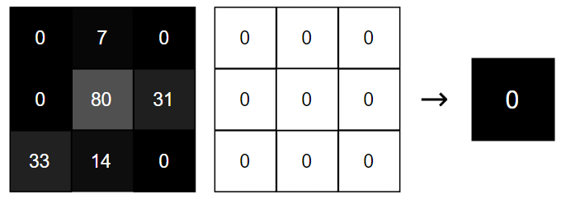
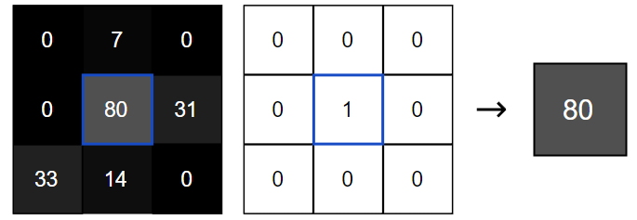
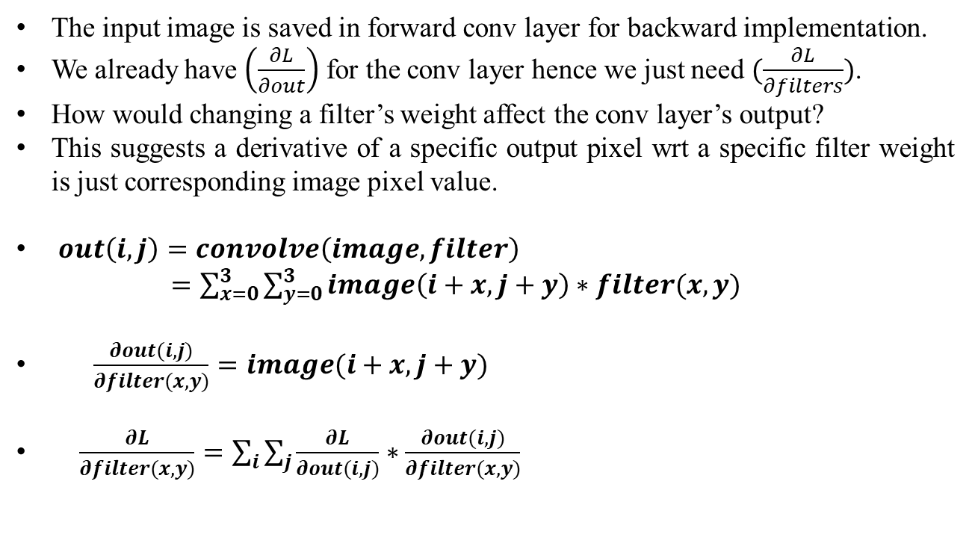
Backpropagation: Convolution filter
The input image is saved in forward conv layer for backward implementation.
We already have $\left(\frac{∂L}{∂out}\right)$ for the conv layer hence we just need $(\frac{∂L}{∂filters})$.
How would changing a filter’s weight affect the conv layer’s output?
This suggests a derivative of a specific output pixel wrt a specific filter weight is just corresponding image pixel value.
$out\left(i,j\right)=convolve\left(image,filter\right)$
$=\sum_{x=0}^{3}{\sum_{y=0}^{3}{image\left(i+x,j+y\right)∗filter(x,y)}}$
$\frac{∂out(i,j)}{∂filter(x,y)}=image(i+x,j+y)$
$\frac{∂L}{∂filter(x,y)}=\sum_{i}{\sum_{j}{\frac{∂L}{∂out(i,j)}∗\frac{∂out(i,j)}{∂filter(x,y)}}}$

Slide 6
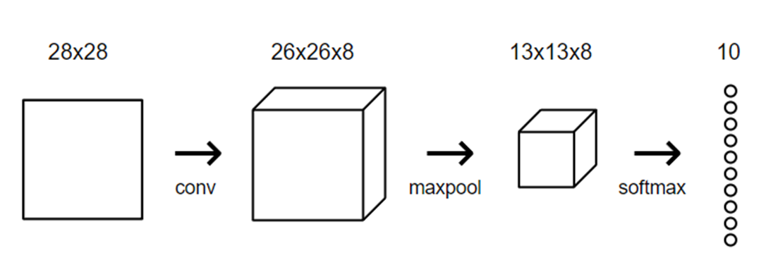













Loss $(L)$
Forward pass
$$(f)$$
$$(w,b)$$
$$\frac{∂L}{∂w}$$
$$\frac{∂L}{∂b}$$
$$\frac{∂L}{∂Input_{s}}$$
$$\frac{∂L}{∂f}$$
$$\frac{∂L}{∂input_{maxP}}$$
$$\frac{∂L}{∂out_{s}}$$
Loss $(L)$
Backpropagation
$$(8×3×3)$$
$$(26×26×8)$$
$$(13×13×8)$$
$$(10×1)$$
$$(1×1)$$

